Slide 1

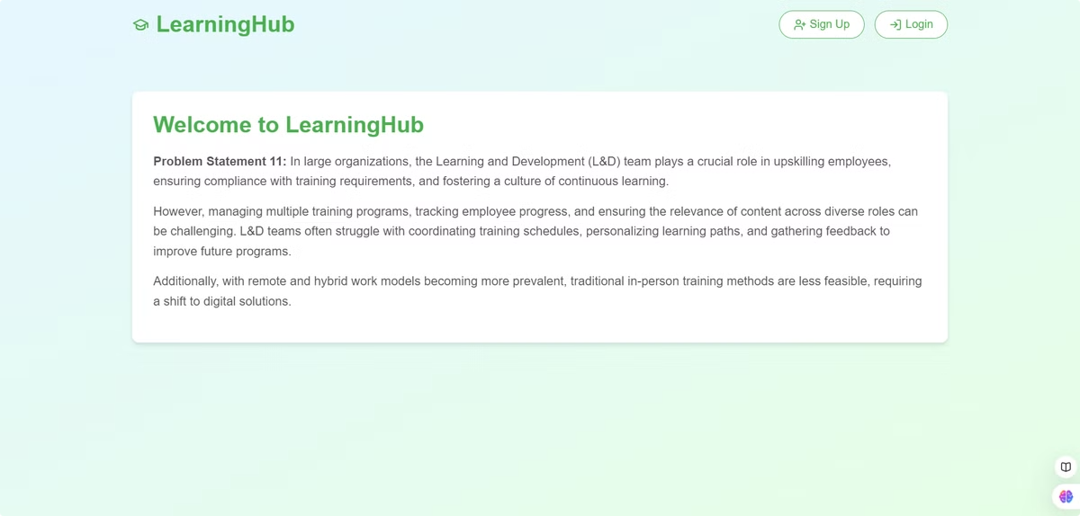
LGD Project Overview
This presentation will provide an overview of the LGD project. The project aims to create a comprehensive Learning and Development platform for your organization.

Slide 2
Project Introduction
Project Goal
Key Features
To develop a web-based learning management system (LMS) for effective employee training and development.
Dashboards for admins, managers, and employees
Progress tracking for individual users
Personalized learning paths

Slide 3
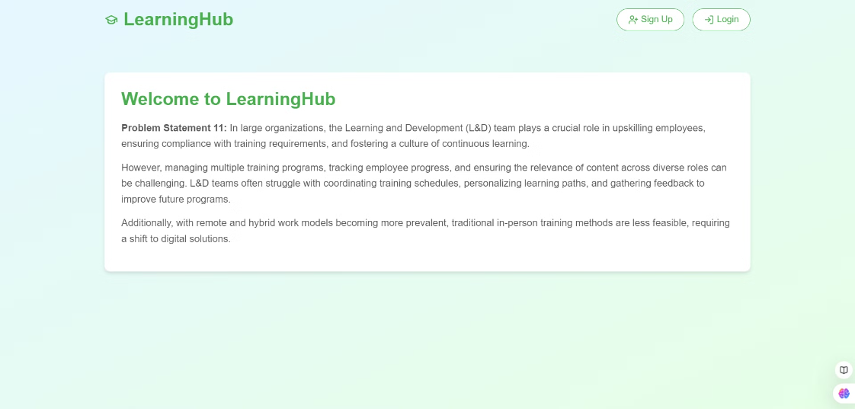



System Architecture
Frontend
1
HTML, CSS, JavaScript
2
Backend
Django framework
3
Database
SQLite

Slide 4
Home Page
Welcome Message
Quick Links
Personalized greeting for users upon login.
Access to key features such as learning modules, progress tracking, and support.
Announcements
Display important updates and announcements.

Slide 5
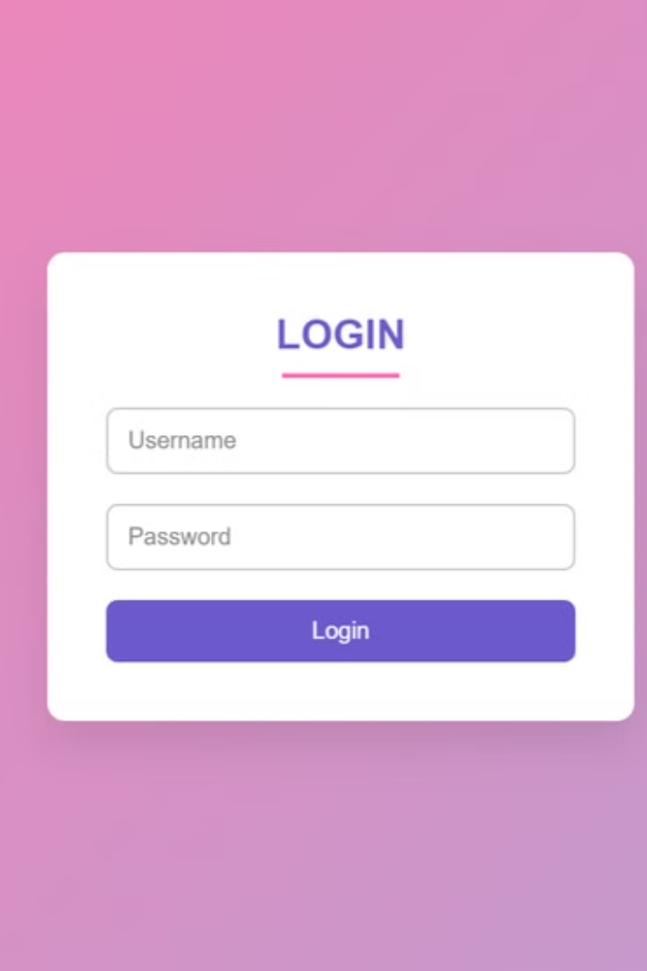



Login Page
Username Input
Password Input
Enter user credentials for authentication.
Securely store and validate passwords.
Login Button
Initiates authentication process and redirects to the appropriate page.

Slide 6

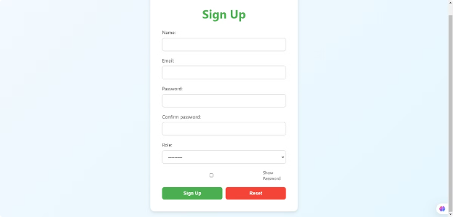
Signup Page
User Information
Password Creation
Account Activation
Collect essential user details, including name, email, and role.
Implement strong password requirements for security.
Send activation link to verify email and complete registration.

Slide 7

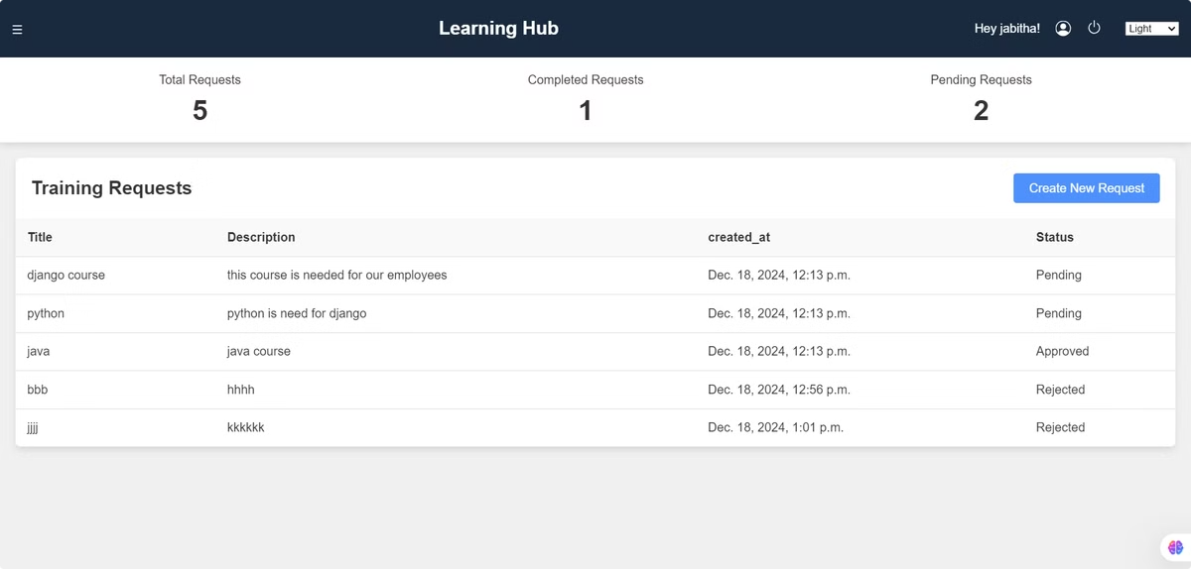
Manager Page
1
Employee Progress
Monitor individual and team progress on learning modules.
2
Training Assignment
Assign specific training programs to team members based on their needs.
3
Performance Feedback
Provide feedback and guidance based on training performance data.

Slide 8


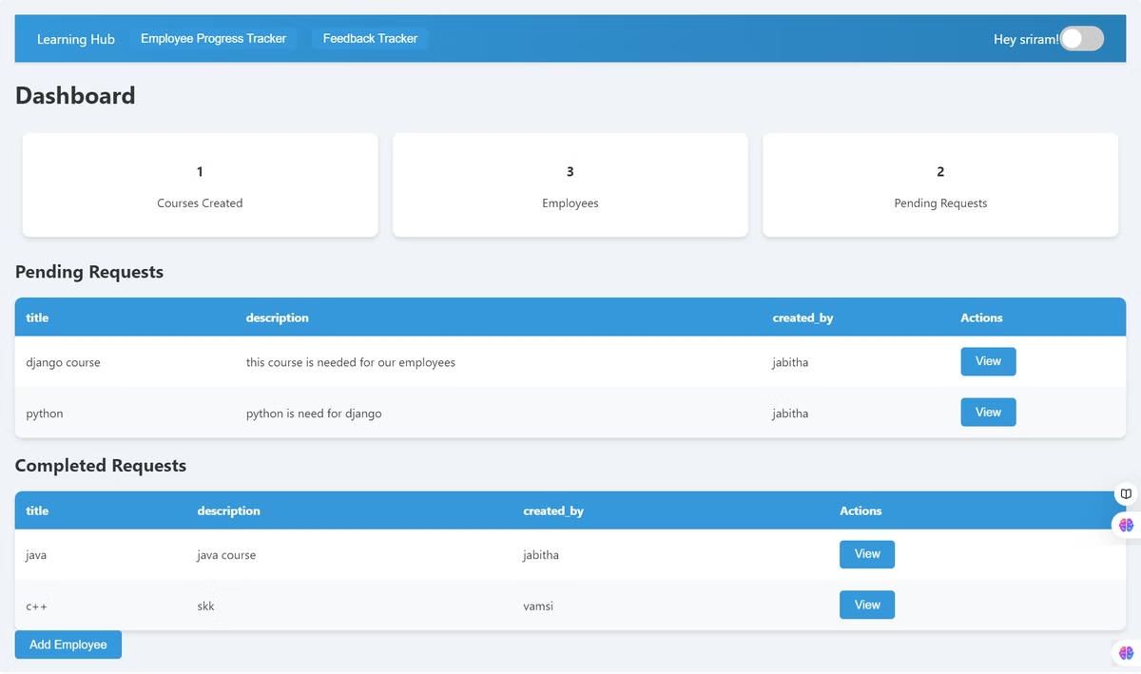


Admin Page
Content Management
Create, edit, and manage learning modules and materials.
User Administration
Add, edit, and manage user accounts and roles.
Reporting and Analytics
Generate reports and analyze data on training effectiveness.

Slide 9
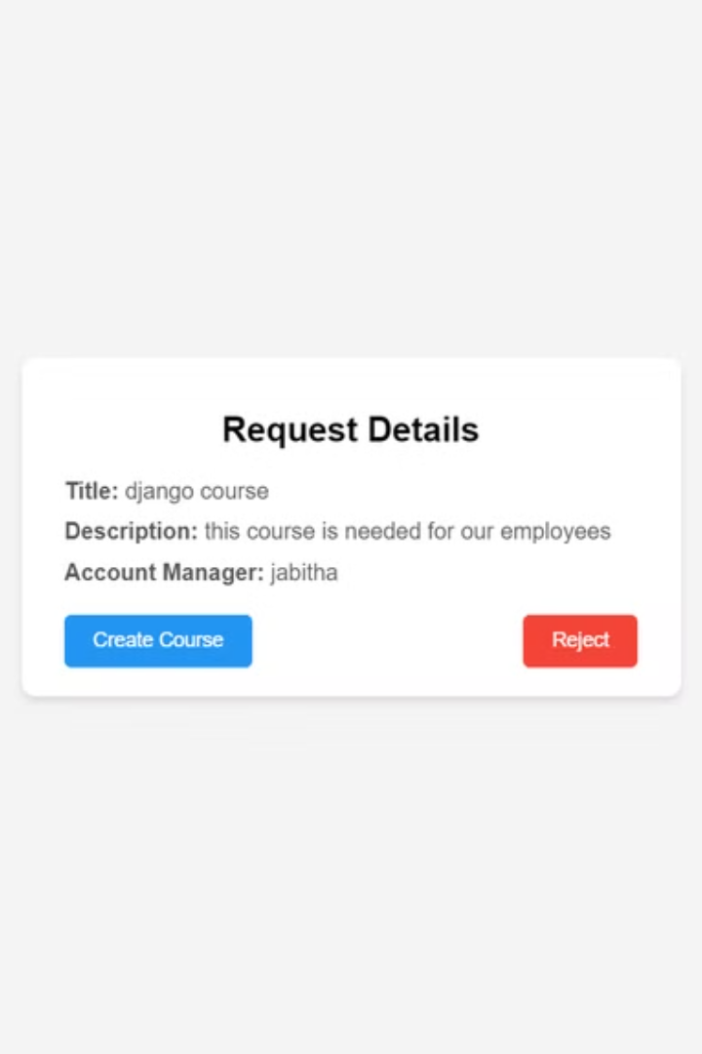
Admin Actions on Training Requests
1
2
Review Request
Approve Request
Admins review training requests from employees or managers.
Admins approve eligible training requests.
3
Assign Training
Admins assign appropriate training modules to the requesting user.

Slide 10
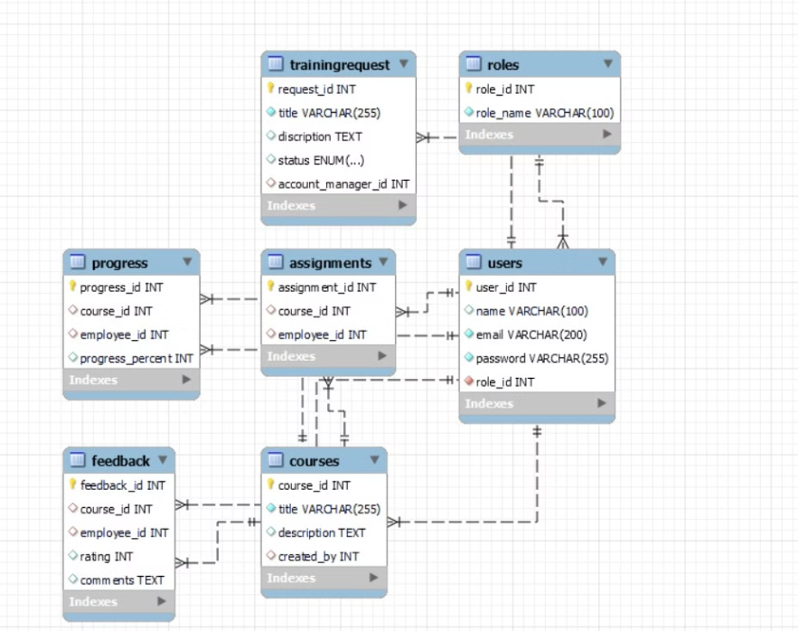


Database Schema

Slide 11
Employee page
Role : Take assigned training course and provide feedback
Responsibilities :
complete courses
provide feedback on courses
Track their own progress

Slide 12
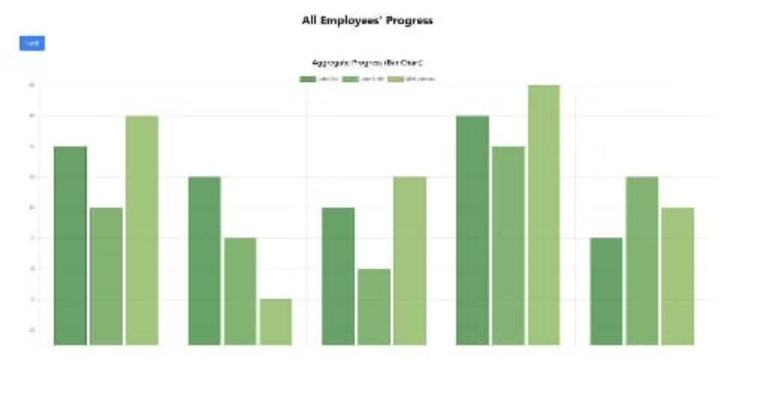
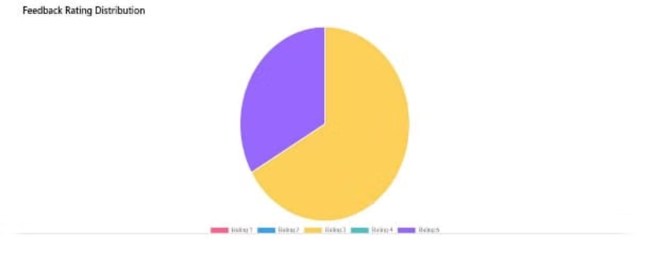
feedback overview
Employee progress tracking
Features : Display course assignment statuses, employee progress and feedback
Features : Track course completion rate and employee performance

Slide 13

Thank You
Thank you for your time and consideration. I am very glad to have this team and very happy to be part of this project.

